Slide 1

Programming in Java
Lecture 5: Objects and Classes

Slide 2
Contents
Class
Object
Defining and adding variables
Nested Classes
Abstract Class

Slide 3
OBJECTS AND CLASS

Slide 4
Class
A class is a collection of fields (data) and methods (procedure or function) that operate on that data.
Circle
centre
radius
circumference()
area()

Slide 5
What is a class?
A class can be defined as a template/ blue print that describe the behaviors/states that object of its type support.
A class is the blueprint from which individual objects are created.
A class defines a new data type which can be used to create objects of that type. Thus, a class is a template for an object, and an object is an instance of a class.

Slide 6




Classes and Objects
A Java program consists of one or more classes.
A class is an abstract description of objects.
Here is an example class:
  class Dog { ...description of a dog goes here... }
  Here are some objects of that class:

Slide 7
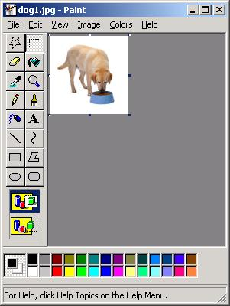
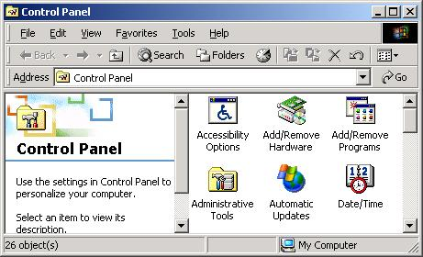
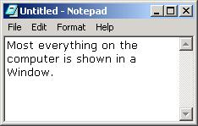
More Objects
Here is another example of a class:
  class Window { ... }
Here are some examples of Windows:

Slide 8
The data, or variables, defined within a class are called instance variables because each instance of the class (that is, each object of the class) contains its own copy of these variables.
The code is contained within methods.
The methods and variables defined within a class are called members of the class.

Slide 9
Defining Classes
The basic syntax for a class definition:
Bare bone class – no fields, no methods
  class ClassName
  {
    [fields declaration]
    [methods declaration]
}
public class Circle {
// my circle class
}

Slide 10
Adding Fields: Class Circle with fields
Add fields
The fields (data) are also called the instance variables.
public class Circle {
public double x, y; // centre coordinate
public double r; // radius of the circle
}

Slide 11
Adding Methods
A class with only data fields has no life. Objects created by such a class cannot respond to any messages.
Methods are declared inside the body of the class but immediately after the declaration of data fields.
The general form of a method declaration is:
type MethodName (parameter-list)
{
Method-body;
}

Slide 12
Adding Methods to Class Circle
public class Circle {
public double x, y; // centre of the circle
public double r; // radius of circle
//Methods to return circumference and area
public double circumference() {
return 2*3.14*r;
}
public double area() {
return 3.14 * r * r;
}
}
Method Body

Slide 13
Accessing Object/Circle Data
ObjectName.VariableName
ObjectName.MethodName(parameter-list)
Circle aCircle = new Circle();
aCircle.x = 2.0 // initialize center and radius
aCircle.y = 2.0
aCircle.r = 1.0

Slide 14
Executing Methods in Object/Circle
Using Object Methods:
sent ‘message’ to aCircle
Circle aCircle = new Circle();
double area;
aCircle.r = 1.0;
area = aCircle.area();

Slide 15
Circle Class
aCircle, bCircle simply refers to a Circle object, It is not an object itself.
aCircle
bCircle
null
null
Points to nothing (Null Reference)
Points to nothing (Null Reference)

Slide 16
Creating objects of a class
An object is an instance of the class which has well-defined attributes and behaviors.
Objects are created dynamically using the new keyword.
aCircle and bCircle refer to Circle objects.
aCircle = new Circle();
bCircle = new Circle();

Slide 17
Creating objects of a class
aCircle = new Circle();
bCircle = new Circle() ;
bCircle = aCircle;

Slide 18
Creating objects of a class
aCircle = new Circle();
bCircle = new Circle() ;
bCircle = aCircle;
Before Assignment
After Assignment
aCircle
bCircle
aCircle
bCircle
P
Q
P
Q

Slide 19
Exercise
Wap to create a class named Student having attributes: rollNumber, name and having methods: insertRecord() and displayInformation() for inserting values in attributes and displaying the attributes information, respectively.
Create main() method in separate class named TestStudent where you have to create 2 student objects, initialize the values of their attributes and display them.

Slide 20
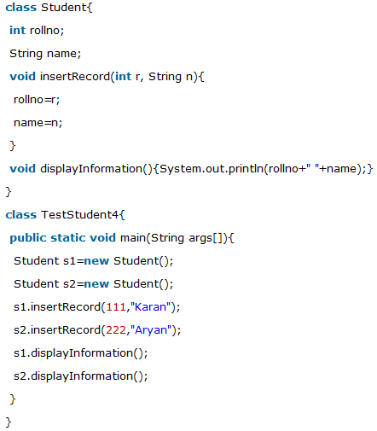

Slide 21
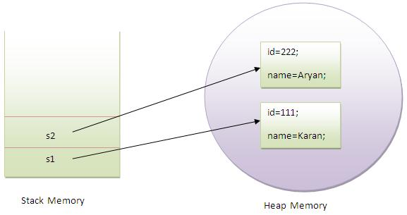

Slide 22
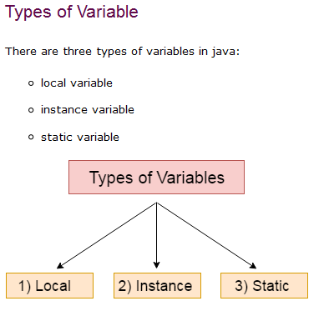
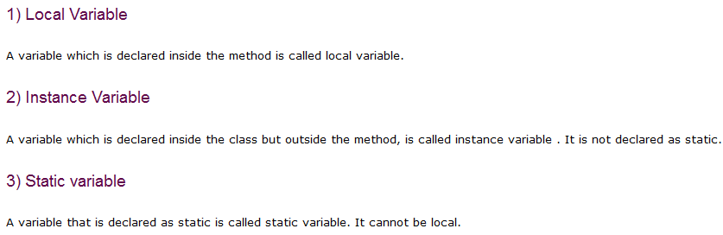

Slide 23
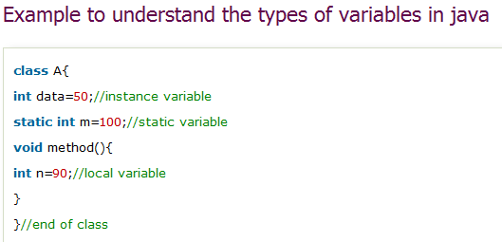

Slide 24
Automatic garbage collection
Q
The object does not have a reference and cannot be used in future.
The object becomes a candidate for automatic garbage collection.
Java automatically collects garbage periodically and releases the memory used to be used in the future.

Slide 25
finalize()
The finalize() method is declared in the java.lang.Object class.
Before an object is garbage collected, the runtime system calls its finalize() method.
The intent is for finalize() to release system resources such as open files or open sockets before getting collected.

Slide 26
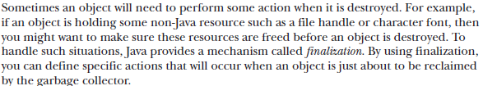
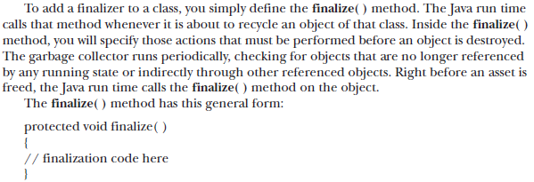

Slide 27
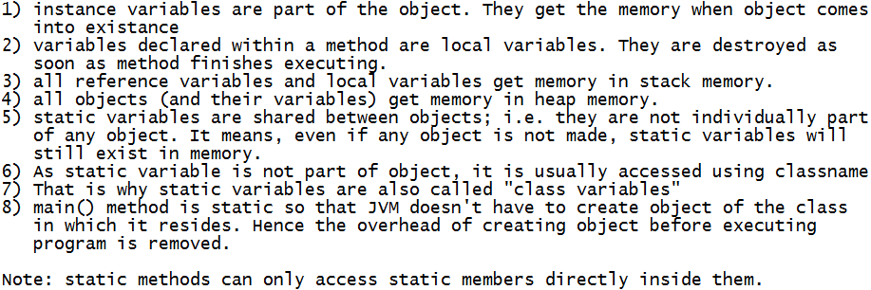
Points to remember

Slide 28
Exercise 1
Wap to create a class name Circle having field: radius and methods that will calculate and return the area and perimeter of circle (using separate method for each).
Now create another class named Demo containing main() method where you have to create a circle class object and display its area and perimeter.

Slide 29
Exercise 2
Wap to create a Circle class having private field: radius and methods:
double area()
double perimeter()
void setRadius(double r) and
double getRadius()
Now make another class named Demo which contains main() and display() method.
Make an object of Circle class in main() method. Initialize it object and pass it to display() method which will be used to display details (i.e. radius, area & perimeter) of that circle object.

Slide 30
Exercise 3
Wap to create a Student class having fields: name, age, marks[5] and having methods:
void setDetails(String name, int age, int marks[]) and void display()
Now create an object of Student class in main(). Set the details of it and display it.

Slide 31
Exercise 4
Write a program to create Student class having fields: name and age and section and displayDetails() method to print the details of object. Now, make the 3 different objects of this class in main() method and assign value to their variables by taking user input and then display all data entered using a displayDetails() method.
Note: And assume that all student belong to same section.
Hint: you don't need to assign section-input for every object individually. Actually, try to assign its value before creating any object.

Slide 32
Exercise 5
Write a program to create class named Mobile_company which contains attributes: mobilesSold, mobileName, mobilePrice and contains methods to assign values to these variables & display details from these variables.
Make a class named Employee having attributes: name and mobileOwned and having methods to assign and fetch values from them.
(Note: mobileOwned variable must be a reference variable of Mobile_Company class and not a String data-type.)
Now make another class named Demo which contains main() method where you have to make some objects of Employee class. Enter and print their details at run-time. Also call a method equipmentSold() which is present in the same class and is used to print no. of mobiles sold by the Mobile_company

Slide 33
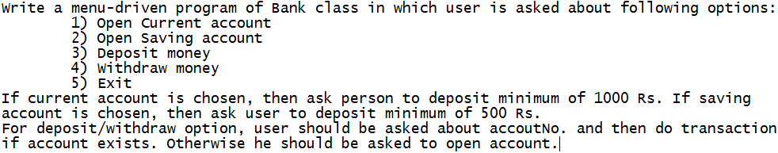
Exercise 6

Slide 34
Questions

